Slide 1
Digital Electronics and Systems

Slide 2
Implement the following Boolean expression using minimum number of NAND gates.
(Qn 1.) f = AB +BC +CD + DA
f = B (A+C) + D (C+A)
f = B (A+C) + D (A+C)
f = (A+C) (B+D)
How many NAND gates are required to implement this function?

Slide 3
f = (A +C) (B+D)
f = (AA +CC) (BB +DD)
AA +CC – 3 NAND gates
BB + DD – 3 NAND gates
AND – 2 NAND gates
Total = 8 NAND gates

Slide 4
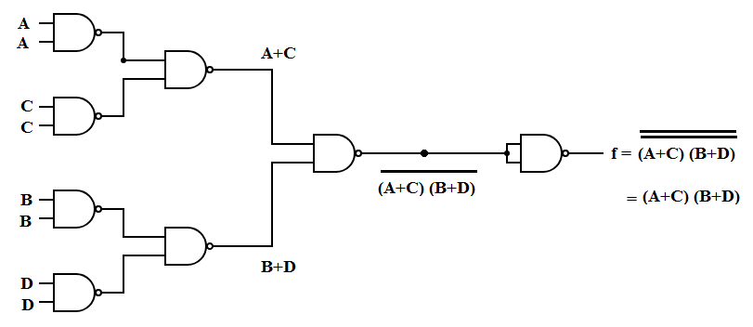

Slide 5
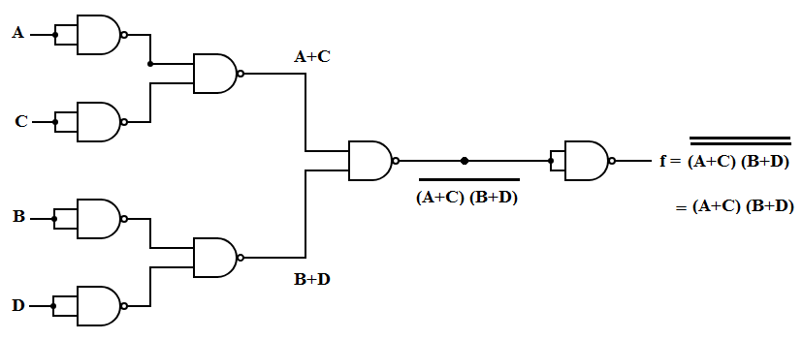

Slide 6
Is it possible to implement this function less than that of 8 gates? YES
f = AB +BC + CD + DA
f = B ( A+C ) + D (A+C)
f = B (AA + CC) + D ( AA +CC ) ------- (1)
AA + CC – 3 NAND gates
Assume AA + CC = x
Equation (1) -- f = Bx + Dx ---- 3 NAND gates
Total = 6 NAND gates

Slide 7
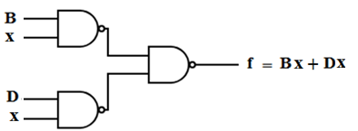

Slide 8
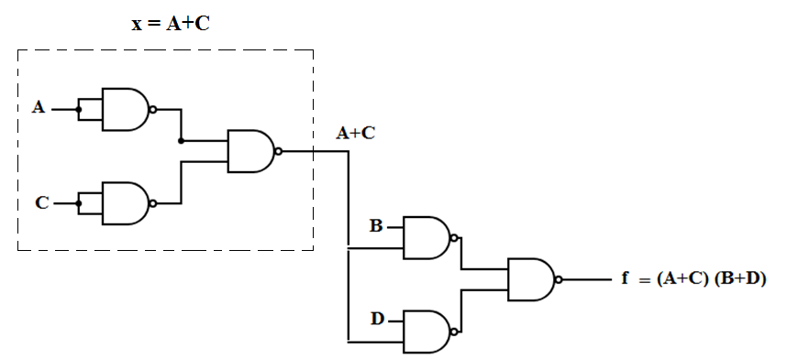
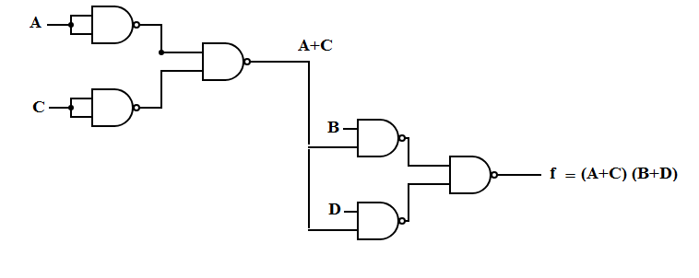

Slide 9
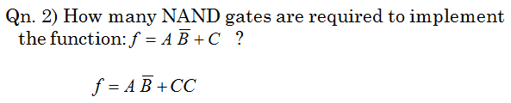
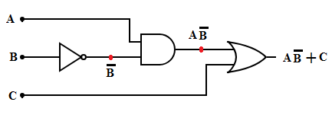
No: of NAND gates = 4
Logic diagram using basic gates

Slide 10
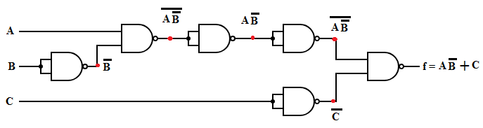


Slide 11
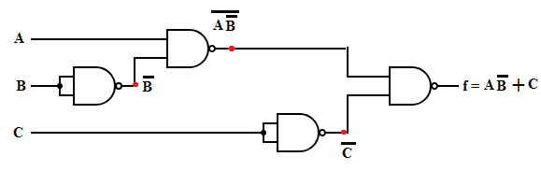

Slide 12

Implement the function using
minimum number of NAND gates.
Step 1: Draw the logic circuit with the help of basic gates.
Step 2: Replace basic gates with NAND gate
Step 3: Eliminate double inversions.

Slide 13
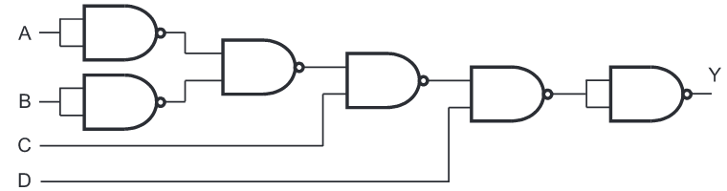
Ans:

